Slide 1


Spring

Slide 2


Agenda
Andreas Evers & Ken Coenen & Tim De Roock
Spring Core

Slide 3
Core Spring

Slide 4
The Spring framework
Alternative to JEE’s EJB model
Simplify Java enterprise application development
JDBC queries, LDAP connections, ...
Reduce dependencies
No dependency cycles in their code

Slide 5
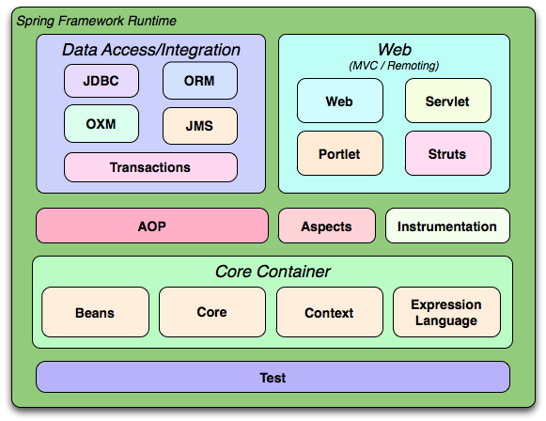
Spring Modules

Slide 6
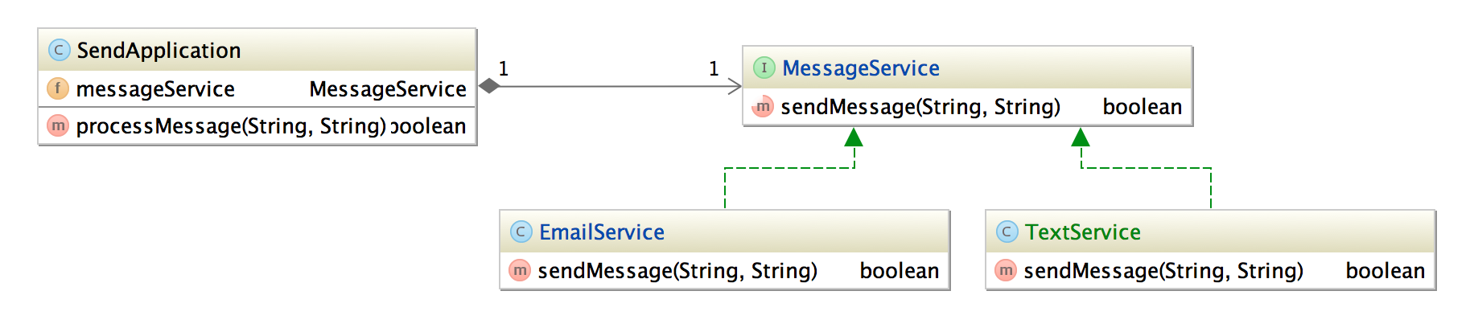
Polymorphism
Example1_Polymorphism.java
Design to interfaces
SendApplication does not know the used implementation because it does not manage its own dependencies
Loose coupling

Slide 7
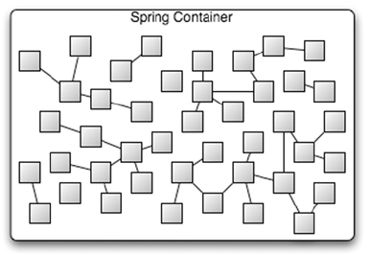
Spring Container
Container of beans
Spring manages the bean lifecycle
Doing a new Xyz() yourself results in an object not managed by Spring

Slide 8
What is a spring bean?
Loaded by the Application Context
Any type of POJO
No need to implement or extend Spring-specific classes
Unique name
Annotated with @Component, @Service, @Repository, @Controller,…

Slide 9
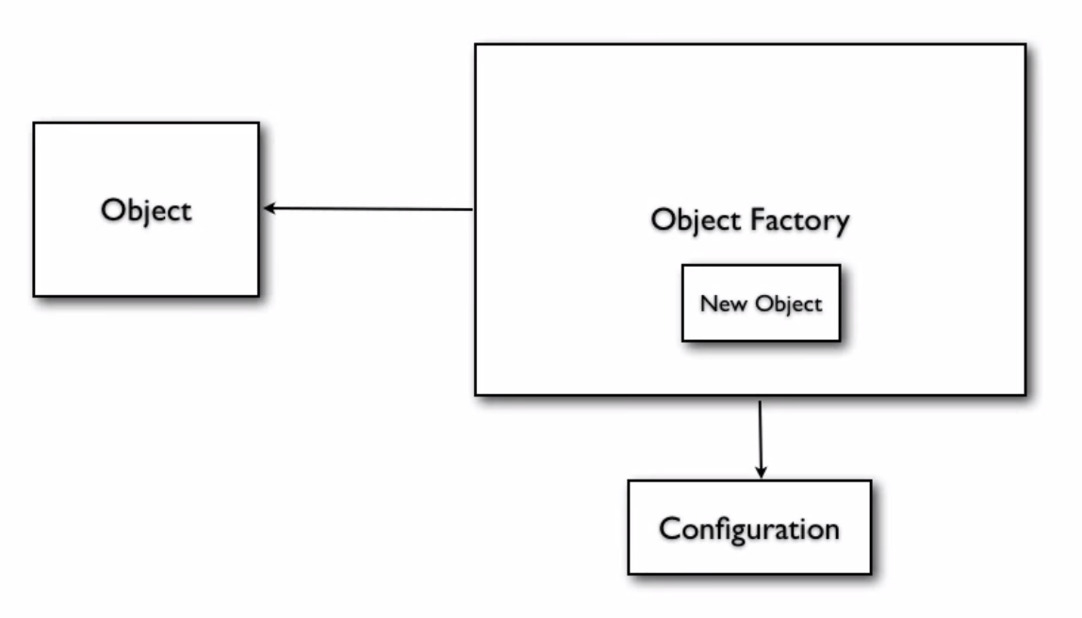
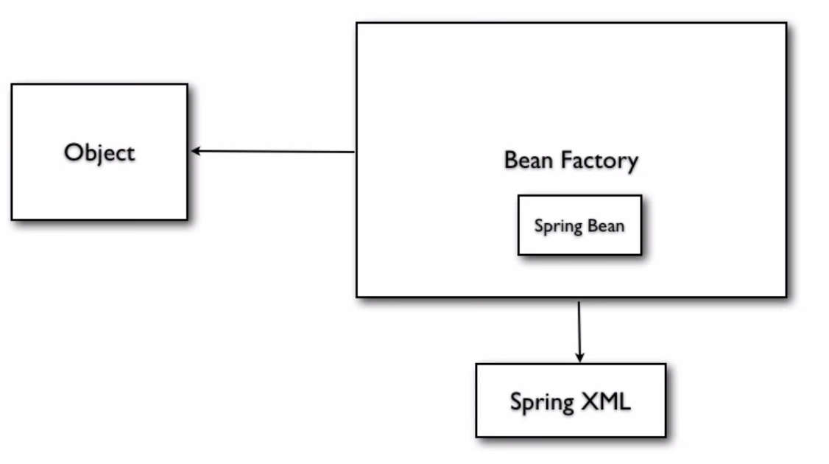
Spring Bean Factory
Example2_BeanFactory.java
Creates beans based on configuration

Slide 10
Bean initialization (XML)
<beans xmlns="http://www.springframework.org/schema/beans"
xmlns:xsi="http://www.w3.org/2001/XMLSchema-instance"
xsi:schemaLocation="http://www.springframework.org/schema/beans
http://www.springframework.org/schema/beans/spring-beans-3.0.xsd">
<bean id=”messageService” class=”be.ordina.spring.service.EmailService” />
</beans>
context.xml

Slide 11
Bean Factory vs. Application Context
Both load beans and wire them together
Application Context offers much more
i18n, AOP, …
Usually we use ApplicationContext
Example3_ApplicationContext.java
Notes:
https://docs.spring.io/spring/docs/current/spring-framework-reference/core.html
The org.springframework.beans and org.springframework.context packages are the basis for Spring Framework’s IoC container. The BeanFactory interface provides an advanced configuration mechanism capable of managing any type of object. ApplicationContext is a sub-interface of BeanFactory. It adds easier integration with Spring’s AOP features; message resource handling (for use in internationalization), event publication; and application-layer specific contexts such as the WebApplicationContext for use in web applications.
In short, the BeanFactory provides the configuration framework and basic functionality, and the ApplicationContext adds more enterprise-specific functionality. The ApplicationContext is a complete superset of the BeanFactory, and is used exclusively in this chapter in descriptions of Spring’s IoC container. For more information on using the BeanFactory instead of the ApplicationContext, refer to The BeanFactory.

Slide 12
Bean example
EmailService.java
package be.ordina.spring.service;
public interface MessageService {
boolean sendMessage(String msg, String receiver);
}
package be.ordina.spring.service;
@Service
public class EmailService implements MessageService {
public boolean sendMessage(String msg, String rec) {
System.out.println("Email Sent to "+rec+ " with Message="+msg);
return true;
}
}

Slide 13
Configure bean properties
Initialize a property through the Spring configuration file
<property>
<constructor-arg>
Example4_PropertyInitialization.java
Example5_ConstructorInjection.java

Slide 14
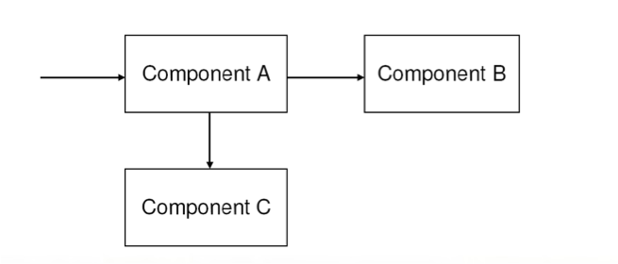
Using dependencies
A typical application system consists of several parts working together to carry out a use case

Slide 15
Before Dependency Injection
Explicit initialization
Results in high coupling between components
Difficult to test
@Component
public class SendApplication {
private MessageService service;
public SendApplication(){
this.service = new EmailService();
}
public boolean processMessage(String msg, String rec){
return this.service.sendMessage(msg, rec);
}
}

Slide 16
Dependency Injection or “wiring”
Also known as Inversion of Control (IoC)
Classes need to know about each other
Links beans together
Results in cleaner code and simplified testing
Swap out the dependency with a different implementation
Field-, setter- or constructor injection
@Autowired

Slide 17
Dependency Injection example
<beans xmlns="http://www.springframework.org/schema/beans"
xmlns:xsi="http://www.w3.org/2001/XMLSchema-instance"
xsi:schemaLocation="http://www.springframework.org/schema/beans
http://www.springframework.org/schema/beans/spring-beans-3.0.xsd">
<bean id="sendApplication" class="be.ordina.spring.components.SendApplication">
<property name="messageService" ref="emailService"/>
</bean>
<bean id="emailService" class="be.ordina.spring.service.EmailService">
<property name="footer" value="Best regards, Ken and Andreas"/>
</bean>
</beans>
Example6_DependencyInjection.java

Slide 18
Injecting Collections
List, Set and Map are supported
<constructor-arg>
<list>
<value>Ken</value>
<value>Andreas</value>
<value>Dieter</value>
<value>Tim</value>
</list>
</constructor-arg>
Example7_Collections.java

Slide 19
Autowiring
Example8_Autowiring.java
Name
Type
Constructor

Slide 20
Bean Scopes
scope attribute on bean element
Singleton
Once per Spring container
Default (!)
Prototype
New object on each ref or getBean
Same as new Xyz()
Request, Session and Global Session (web scopes)
New bean per request, session or global HTTP session
Notes:
What would happen if i add a private member variable?
Oefening:
A)
Make a bean which is injected in 2 services. Increment a private int member. (Which is not static) in the constructor.
Make a method which prints out the value of this variable.
Call this method from your app
B)
Change the scope of the bean to prototype.
Read out the values.

Slide 21
Bean lifecycle hooks
Creation
InitializingBean interface and afterPropertiesSet()
init-method attribute in bean definition
default-init-method attribute in beans definition
@PostConstruct
Destruction
DisposableBean interface and destroy()
destroy-method attribute in bean definition
default-destroy-method attribute in beans definition
@PreDestroy
InitializingBean and DisposableBean have precedence
Notes:
InitializingBean and DisposableBean are Spring specifc, do not use it
Prefer @PostConstruct and @PreDestroy anotations, they also work in JEE context.

Slide 22
BeanPostProcessor and BeanFactoryPostProcessor
Plug in extra functionality
Example is the PropertyPlaceholderConfigurer
<bean class="org.springframework.beans.factory.config.PropertyPlaceholderConfigurer">
<property name="locations" value="classpath:email.properties"/>
</bean>
Example10_PropertyPlaceholderConfigurer.java

Slide 23
Application Context flavors
AnnotationConfigApplicationContext
AnnotationConfigWebApplicationContext
Requires contextConfigLocation parameter in ContextLoader
ClassPathXmlApplicationContext
FileSystemXmlApplicationContext
XmlWebApplicationContext
Notes:
AnnotationConfigApplicationContext load a class which is annotated with @Configuration.
AnnotationConfigWebApplicationContext is the equivalent of AnnotationConfigApplicationContext but for web applications.
ClassPathXmlApplicationContext loads an XML file from the classpath.
XmlWebApplicationContext is the equivalent of GenericXmlApplicationContext for a web application.

Slide 24
Closing an Application Context
Use AbstractApplicationContext
Call registerShutdownHook() for desktop applications to tell Spring it can destory the beans

Slide 25
ApplicationContextAware
Interface to retrieve the Application Context inside a bean
import org.springframework.context.ApplicationContext;
@Service
public class EmailService implements MessageService, ApplicationContextAware {
private static final Logger logger = LoggerFactory.getLogger(EmailService.class);
@Override
public void setApplicationContext(ApplicationContext applicationContext) throws BeansException {
logger.info("Application context is being set!");
}
}
EmailService.java

Slide 26
XML vs. annotations
Different ways to configure your Spring application
XML | Annotation
<bean> | @Bean @Component @Service @Repository
id=”myComponent” | @Component(“myComponent”)
scope=”prototype” | @Scope("prototype")
<qualifier value="myService"/> | @Qualifier(“myService”)

Slide 27
Required
Used for required dependencies
Exception at startup if no applicable bean is found
Verified by a RequiredAnnotationBeanPostProcessor
Example11_Required.java

Slide 28
Autowired
Wire dependencies automatically
Equivalent of XML attribute autowire="byName"
First by @Qualifier (if set), then by type, then by variable name
Realised by a AutowiredAnnotationBeanPostProcessor
Example12_Autowired.java

Slide 29
Bean initialization (annotations)
Different ways
Component scanning
Defining the bean explicitly in the Spring Configuration
Beans are loaded in order of dependency graph
package be.ordina.spring.config;
@Configuration
@ComponentScan(value={"be.ordina.spring"})
public class MyConfiguration {
@Bean
public MessageService messageService(){
return new EmailService();
}
}
When the context is loaded, the MessageService bean can be used by other components!

Slide 30
With Dependency Injection
@Component
public class SendApplication {
//@Autowired
private MessageService service;
// @Autowired
// public SendApplication(MessageService svc){
// this.service=svc;
// }
@Autowired
public void setService(MessageService svc){
this.service=svc;
}
public boolean processMessage(String msg, String rec){
return this.service.sendMessage(msg, rec);
}
}
Field-based DI
Constructor-based DI
Setter-based DI

Slide 31
Running a Spring application (annotations)
package be.ordina.spring;
public class RunDependencyInjection {
public static void main(String... args) {
AnnotationConfigApplicationContext context = new AnnotationConfigApplicationContext(MyConfiguration.class);
SendApplication app = context.getBean(SendApplication.class);
app.processMessage("Hi Ordina!", "info@ordina.be");
//close the context
context.close();
}
}
Example_AnnotationConfig.java

Slide 32
Aspect-Oriented Programming (AOP)
Eliminate repetitive boilerplate code
Security, logging, transaction management

Slide 33
AOP advice types
Around
Most common and powerful
Execute code before and after joinpoint
Before
Executes before joinpoint, cannot stop execution
Throws
Executes code if exception is thrown
After return
Executes code after normal joinpoint execution

Slide 34
Resources
https://github.com/kencoenen/spring-course
https://github.com/andreasevers/spring-aspectj-course
http://javabrains.koushik.org/courses/spring_core
https://spring.io/guides

Slide 35
Questions?

Slide 36
Spring Modules

Slide 37
Agenda
Data access and Integration
Templates and the JDBCTemplate
What is an ORM framework? (Hibernate/JPA)
Spring Data
Transaction Management
Spring Security
Spring Boot
Spring Testing utilities

Slide 38
Data access in Spring

Slide 39
Accessing data in Java
Open connections
Manage transactions
Querying or modifying data
Close connections

Slide 40
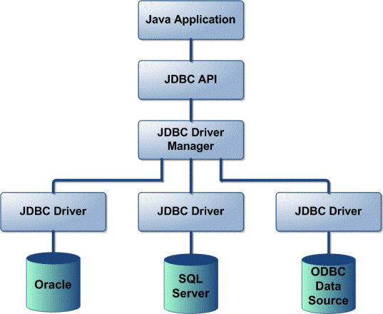
JDBC
Most low-level way in Java
You use the JDBC API
Databases provide their own underlying driver
A lot of boilerplate code (!)
Example1_JDBC.java

Slide 41
JDBC example
Connection conn = null;
try {
Class.forName("org.h2.Driver");
conn = DriverManager.getConnection("jdbc:h2:mem:", "sa", "");
PreparedStatement preparedStatement = conn.prepareStatement("select * from message where id = ?");
preparedStatement.setLong(1, 2L);
rset = preparedStatement.executeQuery();
while (rset.next()) {
logger.info("Message = {}, recipient = {}", rset.getString("message"), rset.getString("recipient"));
}
} catch (SQLException e) {
e.printStackTrace();
} catch (ClassNotFoundException e) {
e.printStackTrace();
} finally {
if (conn != null) {
try {
conn.close();
} catch (SQLException e) {
e.printStackTrace();
}
}
}

Slide 42
Spring JDBC support
Example2_SpringJDBC.java
JDBC module (JDBC template, ...)
Only a few connections per application
Application level vs. method level
DriverManagerDataSource
MessageDaoImpl.java
@Autowired
private DataSource dataSource;
// Ask a connection from the already configured DataSource instead of DriverManager
conn = dataSource.getConnection();
Notes:
We probably connect to only a few databases in an application, so why not isolate the connection creation from the method?

Slide 43
Spring JDBC template
MessageDaoImpl.java
Simplifies querying the database
Eliminates boilerplate code before and after query
Supports select, insert, update, delete
Two options
Create it yourself and inject the DataSource
Define it as a Spring bean for injection into you DAOs
new JdbcTemplate(dataSource).queryForObject("select count(*) from message", Integer.class);
Bye bye boilerplate code!

Slide 44
RowMapper
Maps a Result from a ResultSet into an object
class MessageMapper implements RowMapper<Message> {
@Override
public Message mapRow(ResultSet rs, int rowNum) throws SQLException {
return new Message(rs.getLong("id"), rs.getString("message"), rs.getString("recipient"));
}
}
jdbcTemplate.query("select * from message", new MessageMapper())
MessageDaoImpl.java

Slide 45
NamedParameterJdbcTemplate
Avoid using wildcard ? in long and complex queries
Give names to parameters
Example3_NamedParameter.java

Slide 46
DAO support classes
JdbcDaoSupport
NamedParameterJdbcDaoSupport

Slide 47
Exercise
Load AnnotationConfig context via runnable class (main)
CustomerService
findAll()
get(id)
...
CustomerRepository (return static data initialized by collection injection)
Add logging using Aspects

Slide 48
Spring Boot

Slide 49
Learning Curve for Java Devs
Traditionally very high
Has been even a kind of source of pride
What it takes to be a Java enterprise developer !

Slide 50
Convention Over Configuration
Spring watched what other languages/platforms did
Shrugged it off
“It will never work for the apps I build”

Slide 51
Until Spring Could Ignore No More
RoR, Node
Productivity grew in importance
The bar became too high for new developers

Slide 52
Try Spring Did
Grails did it the Groovy way
Play Framework did it in Java, sort of

Slide 53
What About Spring?
Productivity at heart from the start
Reduce boilerplate code
Intuitive defaults

Slide 54
Much Beyond Spring
App server
Deployment model
3rd party library choices

Slide 55
Previous Attempts
Build a better app server
Smart code generation (aka Spring Roo)

Slide 56
Rise of Full-Stack Java Frameworks
Focus on application development
Little or zero choice to start
Operational aspects

Slide 57
Could Spring Do The Same?
https://jira.spring.io/browse/SPR-9888
Yes We Can

Slide 58
Spring Boot
SPR-9888 / SpringOne 2012
spring.io live launch at SpringOne 2013 … version 0.5.0.M6
1.0.0.RELEASE on April 1, 2014

Slide 59
Spring Boot Adoption
Promising from the start
Success took everyone by surprise
Grails built on Spring Boot

Slide 60
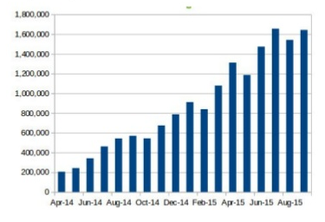
Spring Boot Downloads

Slide 61
Spring Boot Adoption
Runnable server app in a tweet
Opinionated with no strings attached
Security, metrics, health checks
No code generation

Slide 62
What Makes Tweetable App Tick?

Slide 63
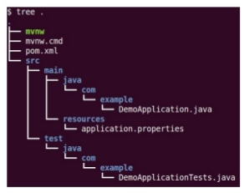
Start Boot Project
http://start.spring.io
Alt + Enter
Save demo.zip

Slide 64
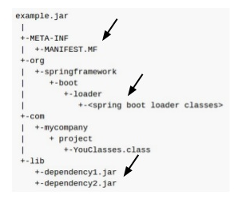
Executable Jar
Single Jar with dependencies
Run with java -jar
Right-click in IDE

Slide 65
Executable Jar Creation
Spring Boot Maven/Gradle plugins
mvn package
Re-packages as executable jar

Slide 66
About Executable Jars
The way command line Java should be
No installation, classpath, scripts
Cloud-friendly

Slide 67
Boot Web Project
http://start.spring.io
Select “Web” dependency
Alt + Enter

Slide 68
Executable Web App Jar
Like “war” but executable
Right-click in IDE … forget web plugins!
java -jar or mvn spring-boot:run (exploded)

Slide 69
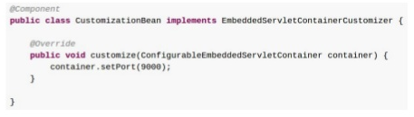
Executable Server
Tomcat, Jetty, Undertow
Customize via application.properties
Programmatically

Slide 70
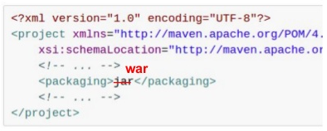
Make Jar Not War
Jar more popular
But it’s easy if you need “.war” war

Slide 71
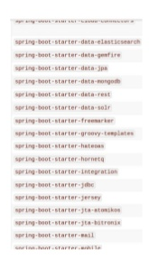
Starter POMs
spring-boot-starter-*
Each starter has group of dependencies
Cohesive versioning

Slide 72
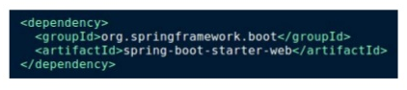
Web Starter POMs
spring-boot-starter-web
Tomcat / Spring MVC / Jackson / Hibernate-Validator
No versions to specify

Slide 73
Auto Configuration
Default Spring config
Opinions based on your classpath
Intelligently adapts to explicit config

Slide 74
Auto Configuration Is Not Magic
Spring Java config + various @Conditional annotations
spring-boot-autoconfigure module
Auto-config report on startup with --debug

Slide 75
What We Have To Start
Executable jar with embedded server
Stack of dependencies
Auto-config

Slide 76
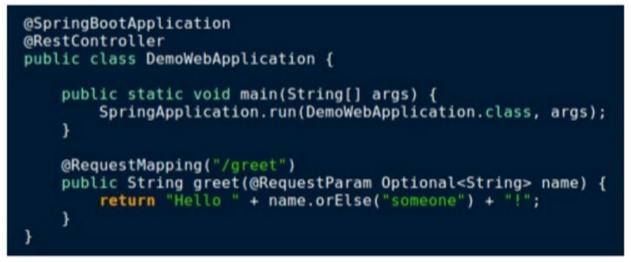
Ready To Code!

Slide 77
Beyond Tweetable Apps

Slide 78
Is This About Getting Started?
It gets even better after getting started
Opinionated but not binding
Production-ready

Slide 79
Actuator
Add spring-boot-starter-actuator
Try built-in endpoints /mappings - request mappings /env - properties /dump - thread dump …

Slide 80
Security
Add spring-boot-starter-security
Try built-in endpoints again
Default username “user” + random password (logged)

Slide 81
Externalized Config
application.properties
Type-safe properties via @ConfigurationProperties
Each auto-config exposes prefixed properties

Slide 82
Developing With Spring Boot
Find a starter pom
Read up docs for related auto-config
See available properties exposed by auto-config
Browse *AutoConfiguration classes when needed

Slide 83
Working With Static Resources

Slide 84
Static Resources - html, js, css
Bundled in executable jar
“/**” served from /static , /public, /resources
“/webjars/**” served from jar files in Webjars format

Slide 85
Reloading Static Resources
mvn spring-boot:run (exploded)
IDE hot reloading in debug mode
Use Spring profiles with “file:” location in “dev”

Slide 86
Reloading With Dev Tools (new in 1.3)
Auto restart after changes
Works with LiveReload in browser
Develop with pleasure

Slide 87
Testing with Spring MVC Test
Server-side integration tests
Container-less using mock request & response
Fluent API
HtmlUnit, WebDriver, Geb integration

Slide 88
@WebIntegrationTest
Spring Boot test annotation
Spin up web app including embedded container
TestRestTemplate to perform requests

Slide 89
Servlets & Spring MVC

Slide 90
Agenda
Java web applications
Servlets
Web application deployment descriptors (Servlet 2.4)
Servlet 3 annotations
Scopes (Context, Session, Request, Page)
Multithreading/concurrency
Listeners
Front-controller pattern -> MVC’s
Spring MVC
DispatcherServlet
Registering Servlets/Filters in ApplicationContexts
Controllers (xml & annotations)
View resolvers
REST (& (Un)Marshallers)

Slide 91
Servlets
Request/Response handling
Managed by Web application container (Tomcat etc…)
Mostly used for handling HTTP requests (HttpServlet)
Service methods are used to handle incoming requests
GenericServlet.service
HttpServlet.doGet & HttpServlet.doPost

Slide 92
Filters
Components intercepting the requests before being handed over to Servlets
Useful when performing initialisation before each request

Slide 93
Web app configuration
Deployment descriptors (Servlet 2.4)
web.xml
servlet-mapping / servlet
init-param
filter-mapping /filter
Servlet 3 config (No config…)
@WebServlet annotation
@WebInitParam

Slide 94
Scopes
Context
Session
Request
Page

Slide 95
Multithreading considerations
1 Thread per request
Container instantiates Thread
Things to consider when using servlets
NO INSTANCE VARIABLES
DON’T USE @Synchronised on service(service, doGet, doPost) methods
DON’T IMPLEMENT SingleThreadModel

Slide 96
Listeners
ContextListener, ContextAttributeListener
SessionListener, SessionAttributeListener
RequestListener, RequestAttributeListener
…

Slide 97
Front-controller pattern
Old style -> Servlet per page
Front-controller pattern -> 1 Servlet as entrypoint, delegates to ‘helper components’
MVC frameworks implement this -> Spring MVC, JSF, Struts, …

Slide 98
Spring MVC

